Slide 1
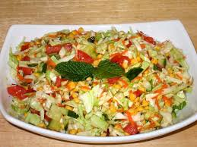
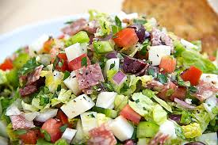
INDIAN AND ITALIAN SALAD

Slide 2
Salads play a very important role in any meal. Indian food and Italian meals are incomplete without serving healthy salad dishes. We consume various food items on daily basis and none of them is as important as salad. That’s why salad is considered as a “King or Prince of the Menu”.

Slide 3
Doctors always advise to eat a healthy salad on daily basis, it may be vegetable salad, fruit salad, mixed salad, etc. Today in such a stressful life, healthy food is an essential phenomenon, that provides multivitamins to our body. Eating healthy salad becomes necessary to run smoothly in the life. Eating healthy salad is a good habit, that must be adopted by everyone and anyone.

Slide 4
Salad is an amazing treat to the taste buds and people of some countries even do not sit on the dinning tables, if salad is not accompanied in their meal.You can make variety of healthy and tasty salads, it is always advisable to accompany the nutritional and diet salad in your daily meal.

Slide 5
Eating salads is a super-convenient way to work in a couple of servings of vegetables and/or fruit. Green salads are on the menu of almost every restaurant. You can even buy a side salad (with Romaine lettuce, carrots and tomatoes, available with fat-free or reduced-calorie salad dressing) for a buck at many fast food chains these days. And you can make a green salad at home in 5 minutes, armed with a bag of pre-washed salad greens, a few carrots or other veggies, and a bottle of light salad dressing.
them to include the fruits and vegetables that appeal to you the most, and whichever ones you have on hand.

Slide 6
Here are four health reasons to reach for a salad today:
2. Eat Salads for the Health Benefits of Fruits and Vegetables
If you frequently eat green salads, you'll likely have higher blood levels of a host of powerful antioxidants (vitamin C and E, folic acid, lycopene, and alpha- and beta-carotene,) especially if your salad includes some raw vegetables. Antioxidants are substances that help protect the body from damage caused by harmful molecules called free radicals.

Slide 7
3. Eat Salads to Cut Calories and Increase Satisfaction
If losing weight is your goal, you may want to start your meals with a green salad. Studies have shown that eating a low-calorie first course, like a green salad of 150 calories or less, enhances satiety (feelings of fullness) and reduces the total number of calories eaten during the meal.

Slide 8
By
Srujan house
Pradyun
Riddhi
Taneesha

