Slide 1
Abhay house
Indian Tit-Bit Salad
Italian Fruity-Cutie Salad

Slide 2
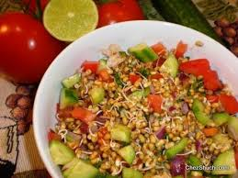
Indian TIT BIT SALAD
Ingredients
Method
Nutritional Values
Importance of Salads
Images

Slide 3
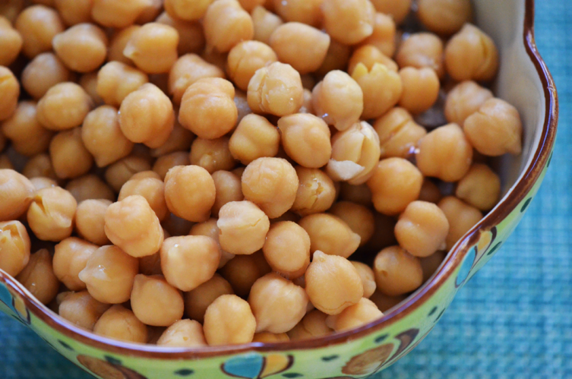
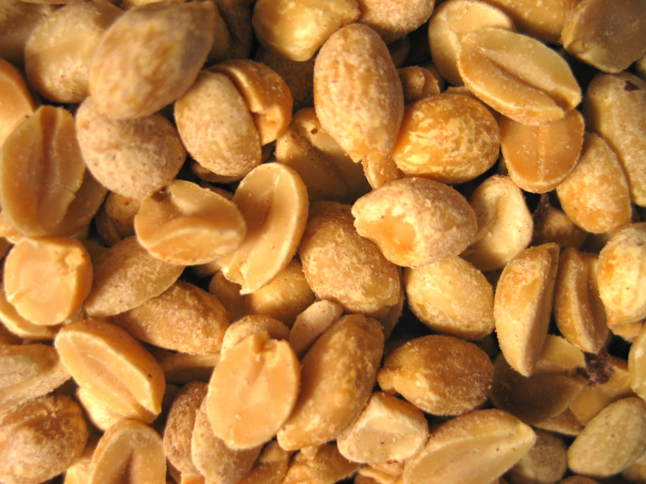
Ingredients
1 bowl Boiled Chick Peas
1 bowl Roasted Peanuts
2 tbsp Cucumber
2 tbsp Tomato
2 tbsp Apple
2 tbsp Pomegranate
2 tbsp Chat Masala
2 tbsp Salt
1 ts Lemon Juice
½ cup Dal Mooth
2 tbsp Coriander
2 tbsp Green Chillies
2 tbsp Capsicum / Corn

Slide 4
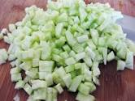
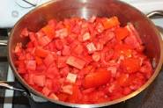
Method
Chop the veggies and fruits.
Mix them all well.
Then mix Chick Peas, Roasted Peanuts and Lemon Juice well.
Add Salt and Chat Masala.
Garnish it with coriander and Dal Mooth.
YOUR INDIAN TIT BIT SALAD IS READY TO SERVE!!

Slide 5
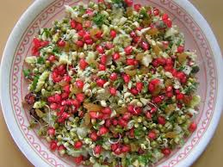
Nutritional Values
This salad is a good source of dietary fibre, proteins, vitamins, copper, phosphorus, manganese and potassium.

Slide 6
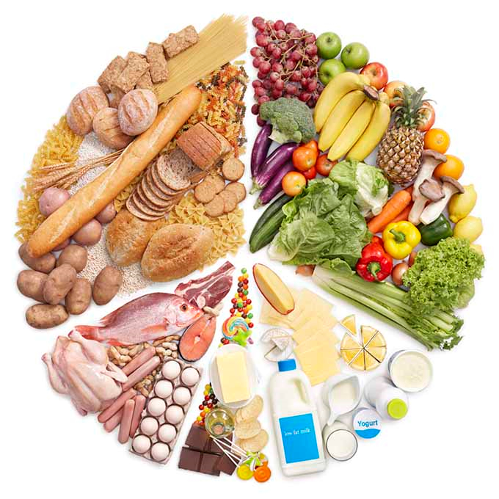
Importance of Salad
Eating healthy salad is necessary to run smoothly in the life. Eating healthy salad is a good habit, that must be adopted by everyone.

Slide 7
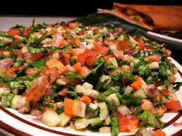
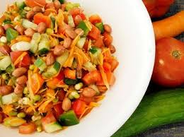
Images

Slide 8
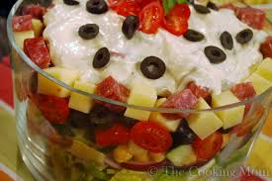
Italian FRUITY Cutie Salad
Ingredients
Method
Nutritional Values
Importance of Salads
Images

Slide 9
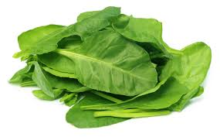
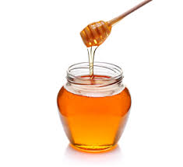
ingredients
Cucumber Capsicum
Pomegranate Honey
Spinach Orange Juice
Tomato Salt
Coriander

Slide 10
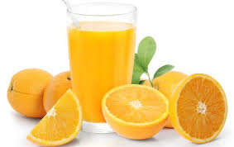
method
Chop the veggies and fruits.
Put them all in a bowl.
Add salt and a bit of orange juice.
Blend well.
AND YOUR ITALIAN FRUITY CUTIE SALAD IS READY TO SERVE!!

Slide 11
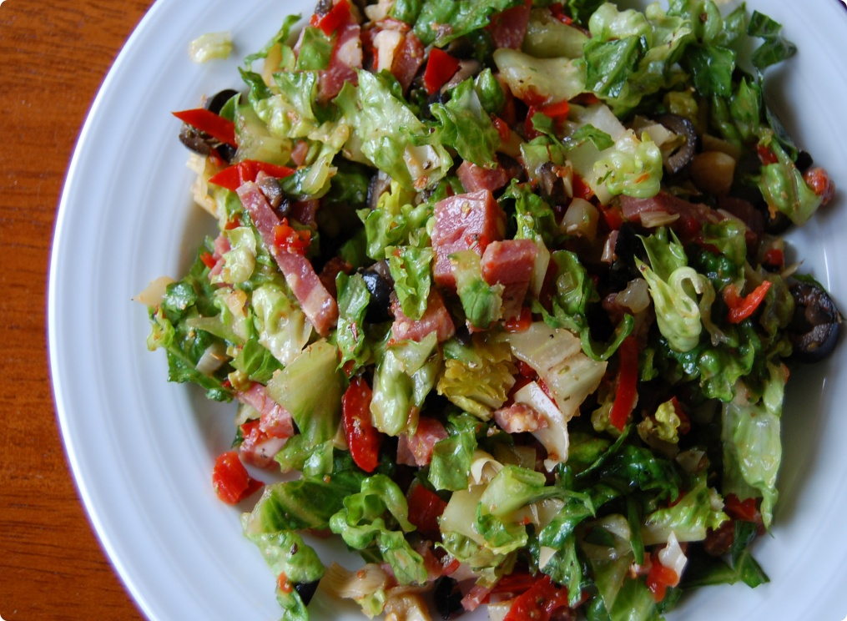
Nutritional values
Calories 23
Total Fat 15g
Saturated Fat 0.8g
Sodium 2780mg
Carbohydrates 14g
Dietary Fiber 5g
Sugars 6g
Proteins 28g

Slide 12
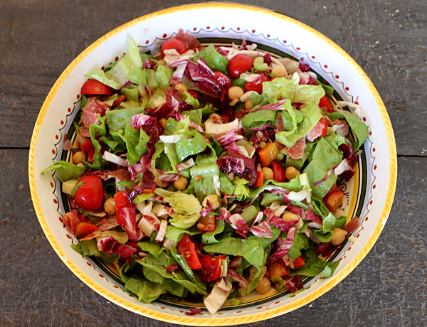
IMPORTANCE
This salad is a good source of Proteins ,Carbohydrates ,Minerals etc.that must be consumed by our body.Hence,we must have this salad for minimum one meal.

Slide 13
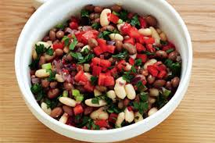
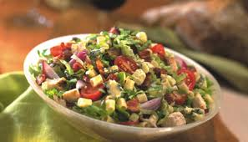
images

Slide 14
THANK YOU
BY
ABHAY HOUSE

