Slide 1
Pop-Up Museum
& Pre-Colonial Africa

Slide 2
What do you mean “pop-Up”?
Something that comes for only a short time and then it’s gone.
Think of the onomatopoeia “Pop” (very sudden, big impact, but then it ends)
You can pop-up and scare someone. → it happens very quickly
You can pop-in and visit someone → it is unannounced, happens randomly

Slide 3
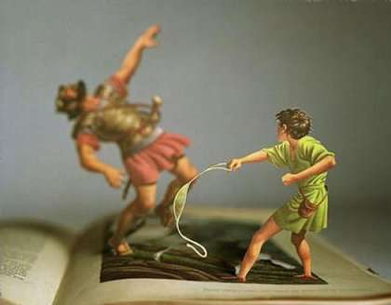
Pop-up Book

Slide 4
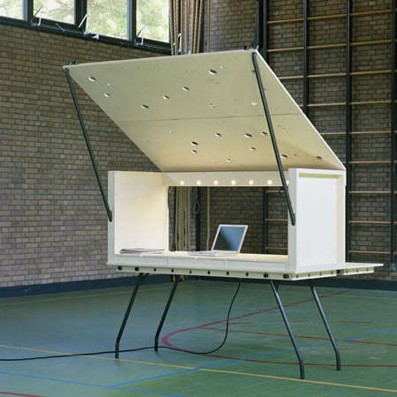
Pop-up Office

Slide 5
Pop-up Store

Slide 6
What is a pop-Up Museum?
A space where artifacts “pop-up” and are available for a short time. Soon they will be gone.
Available space? Parts of the walls and windows!
Our Pop-Up Museum topic: Pre-Colonial Africa Artifacts

Slide 7
What will you be doing?
Take your artifact analysis organizer to your designate image.
Examine the image. Read captions and context.
Look at prompt, questions on sheet. Discuss with classmates. Record your ideas.
Move clockwise at my instruction.
Time at each station: we will start with 4-5 minutes per station.

Slide 8
What do pre-colonial African artifacts show us about their culture?
(Our Essential Question)

Slide 9
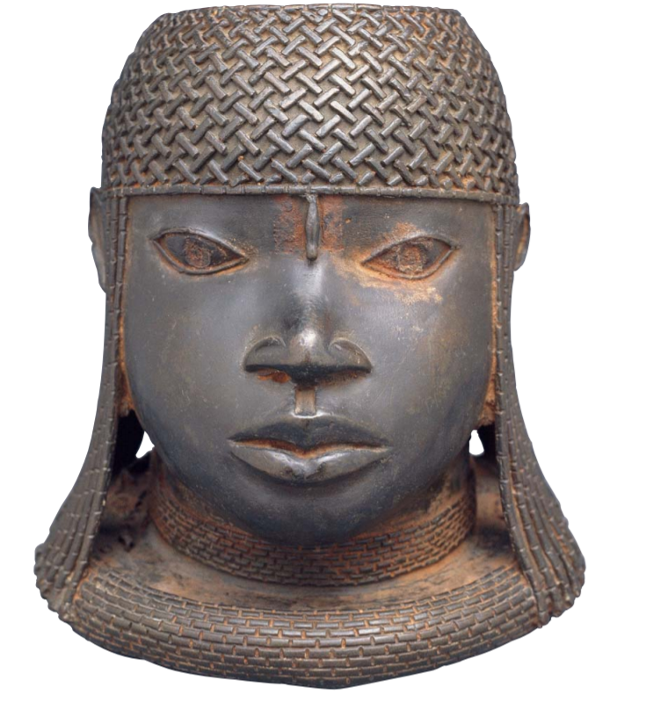
Example
Head of an Oba, from Benin (about 1550, present day Nigeria)
Context: Cast brass heads, replicas, of Obas, the leaders or kings, were ordered by the kings of Benin to be placed on royal ancestor altars. The Obas were considered to be partially divine (god-like). When they came to the throne, one of the first things they had to do was create an altar honoring the previous Oba/King. Iron (type of metal used) was thought to represent unstoppable strength.

Slide 10
Artifacts
Image A: Ivory Salt Cellar from Benin (1525-1600, ivory, present day Nigeria)
Image B: Brass Plaque-Oba on Horseback (1550-1680, Brass, Benin, present day Nigeria)
Image C: Image D: Pendant Mask from Benin (16th century, Ivory)
Image D: Seated Figure from Mali (1235, Terracota)
Image E: Asante Gold-Weights (circa 1700, brass, present day Ghana)

Slide 11
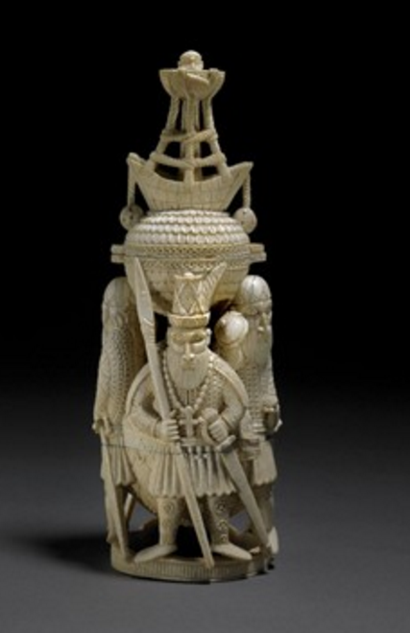
Image A
Ivory Salt Cellar
1525-1600, made of Ivory
Benin Empire, Present-day Nigeria
This salt cellar is made of ivory and objects such as these were perhaps the first known examples of “tourist art” in Africa as they were made specifically for foreigners/visitors.

Slide 12
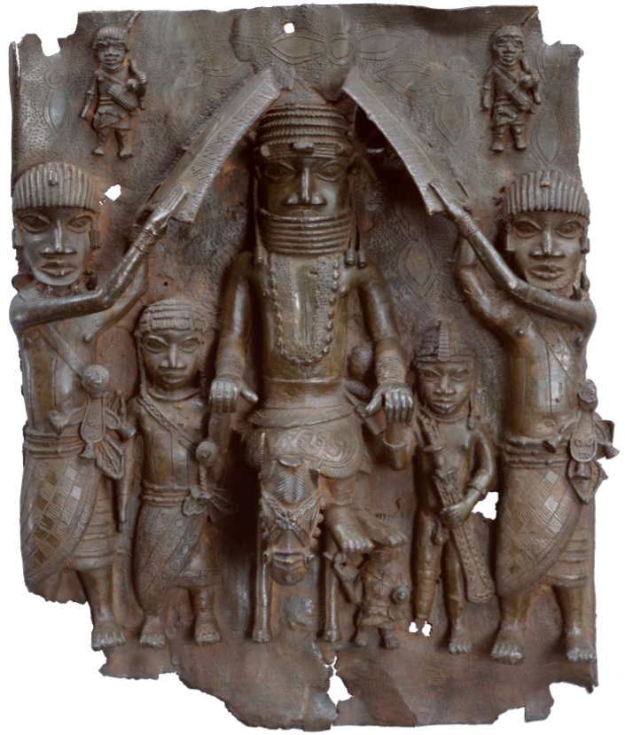
Image B
Plaque- “Oba on Horseback”
1550-1680, made of brass
Benin Empire, Edo peoples, Present-day Nigeria
This is just one many plaques created. They show the Oba and various people involved in his life. The plaques were mounted on the palace pillars by nails. The size of a person on a plaque indicts their importance. The use of brass, a very expensive and rare metal at the time, on this plaque shows the Oba’s control and power, who was the only one allowed to use Brass.

Slide 13
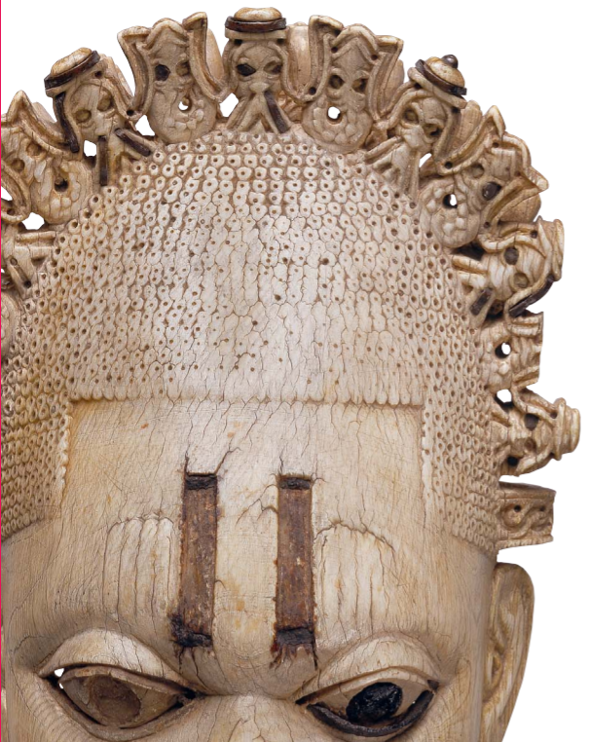
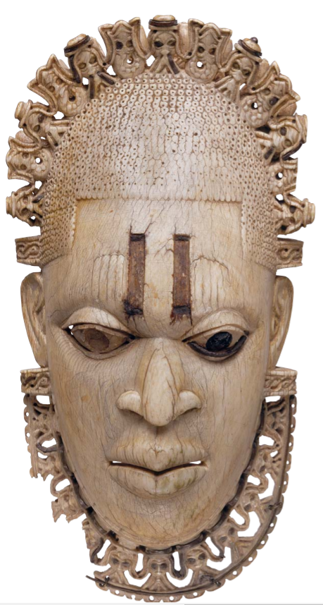
Image C
Pendant Mask
16th century, Benin Empire, Edo peoples, present-day Nigeria
This pendant mask was created in the 16th century for an Oba, king, named Esigie, in honor of his mother Idia. She has a choker/necklace and crown with Portuguese figures and mudfish. The 4 marks on either side of her forehead are scarification marks and the number indicates her female gender.

Slide 14
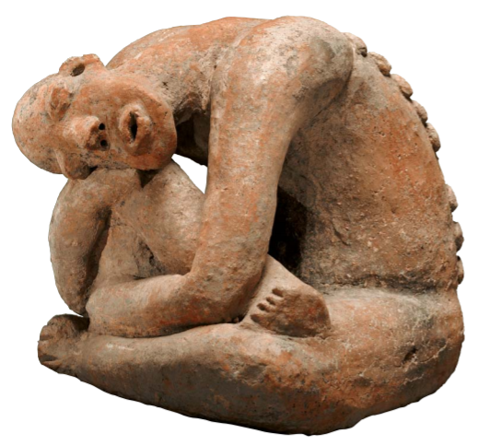
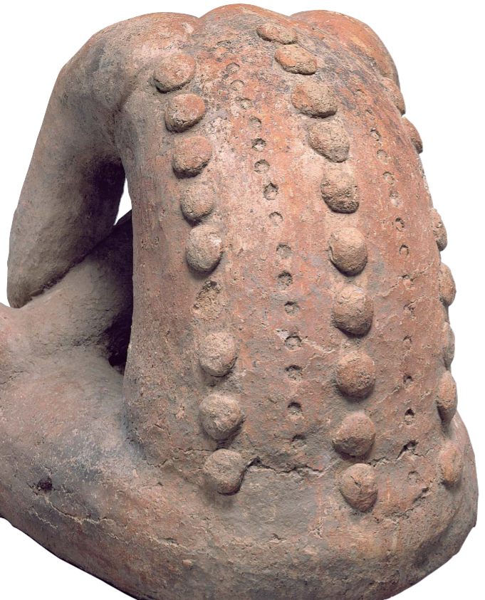
Image D
13th Century, about 1235, made of Terracotta
Mali empire (present day Niger)
The terracotta figures associated with this civilization represent men and women doing a variety of things.
Artists modeled these types of figures by hand and the variety of different types, people, and images depicted show the freedom the artists had.

Slide 15
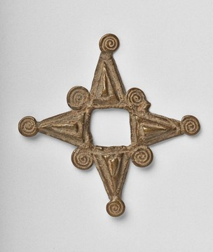
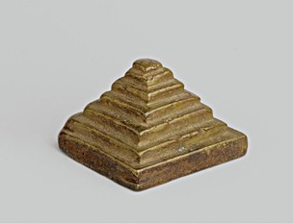
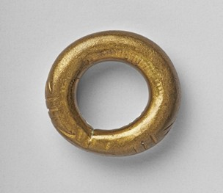
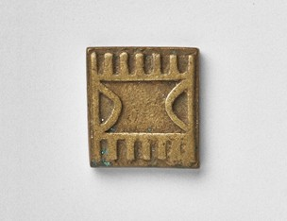
Image E
Gold-Weights of various shapes and sizes
About 1700, made of brass by the Asante, Akan peoples, Present-day Ghana
Gold was a natural resource in many parts of West Africa, hence its nickname “Gold Coast” by Europeans. These small figures were created with brass and served as the first gold-weighing system for the trade at the time. The Europeans, mainly Portuguese, traded various items like guns for gold. The weights were used to ensure fair trades and measure the weight of gold being traded.

