Slide 1
Mosaics & the Byzantine Empire

Slide 3
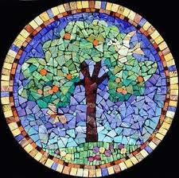

Slide 4
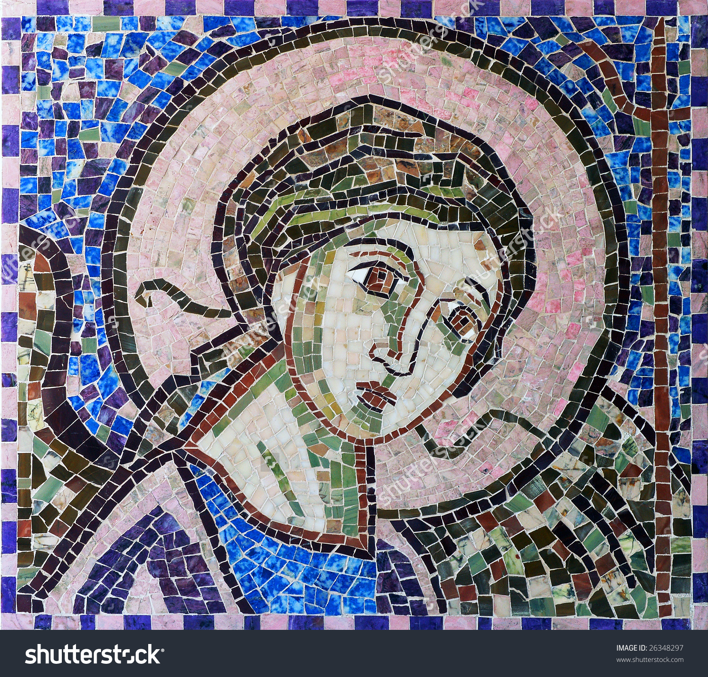

Slide 5
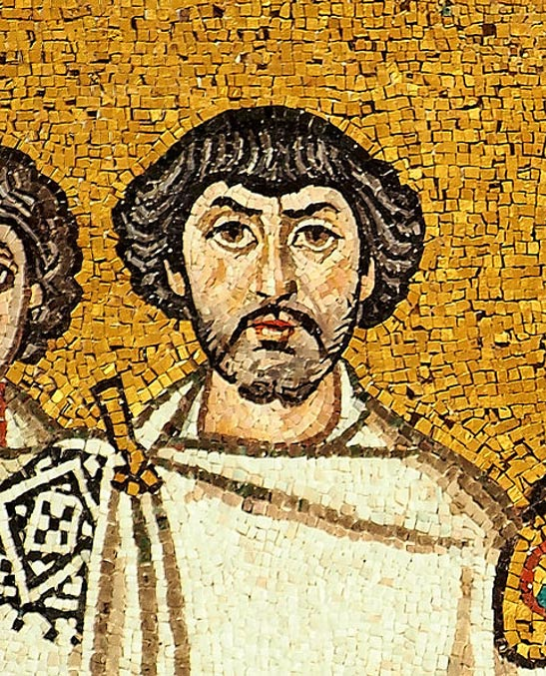

Slide 6
1st Period

Slide 7
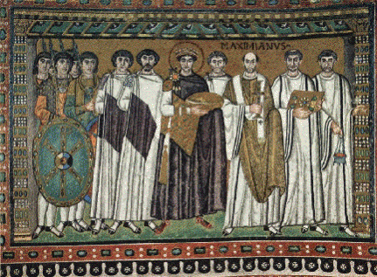

Slide 8
2nd Period

Slide 9
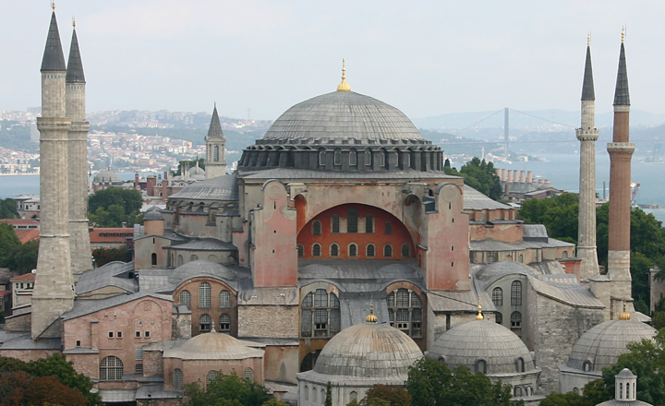

Slide 10
6th Period

Slide 11
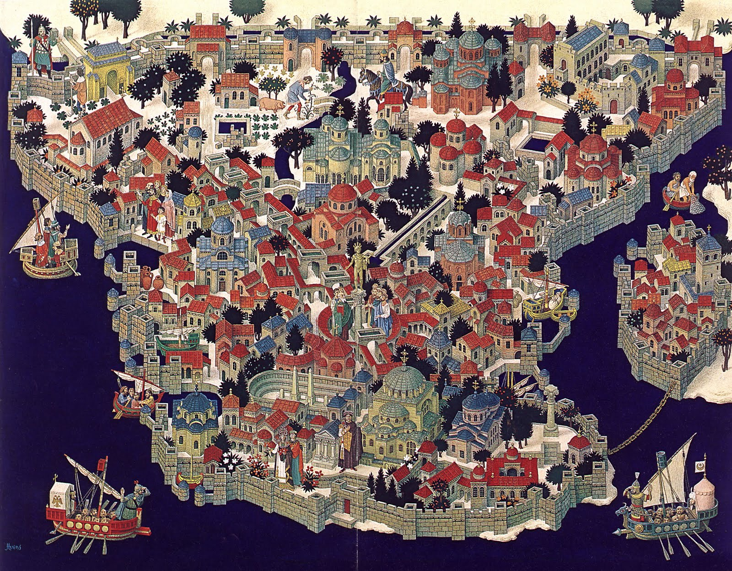

Slide 12
7th Period

Slide 13
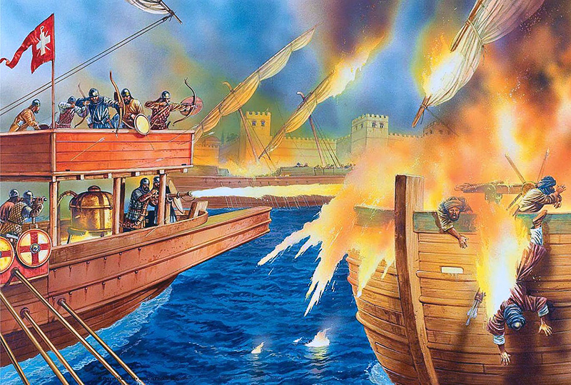

Slide 14
Tips
Use ISN page 83 for practice drawing your “tile”
Match up images in the right places on your tile
Sketch/draw first, THEN work on adding color
Use technology to zoom in on your image.

