Slide 1
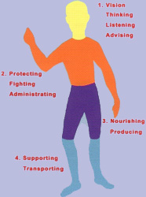
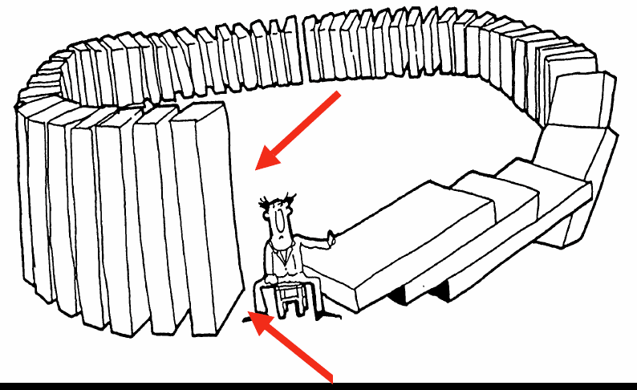
Hinduism Homework
2
Which picture goes with which term?
Terms: Karma, Reincarnation, Dharma
1
Label each statement about Hinduism with the correct 5 Themes of Geography. There are no repeats
Hinduism spread to parts of South and Southeast Asia through trade routes.
____________________
Hinduism was started in the Indus Valley area about 3000 BCE.
____________________
Ganges River is considered a holy land in Hinduism.
____________________
Some Hindu beliefs (like the sacred cow and bathing in the Ganges River) have led to problems with the environment
____________________
Most Hindus today live in India, which is South of Nepal and Southeast of Pakistan.
____________________
3
Karma
Reincarnation
Dharma
Polytheism
Hinduism
Diety/Dieties
Belief in many gods
Gods/Goddesses
A 4000-5000 year old religion, started in India.
What you do matters; good deeds will give you rewards
Being reborn into another life after you die
Deeds/Actions/Laws that are expected of you
Match the definition to the correct term.

