Slide 1
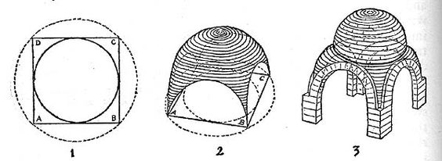

Slide 2
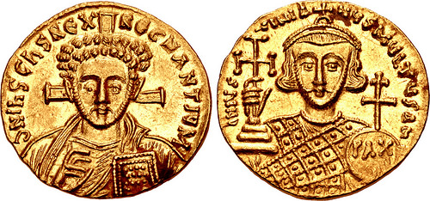

Slide 4
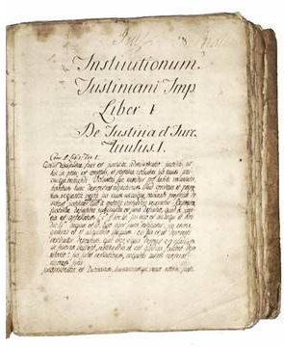

Slide 7
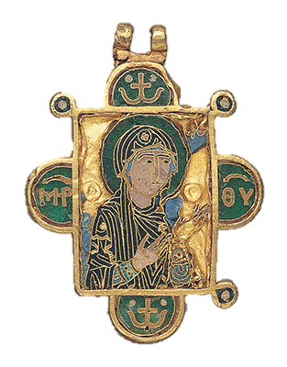
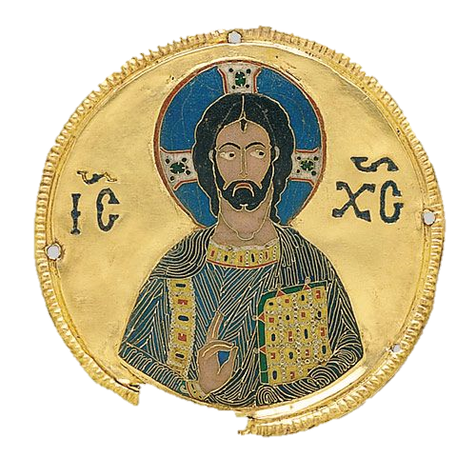

Slide 13
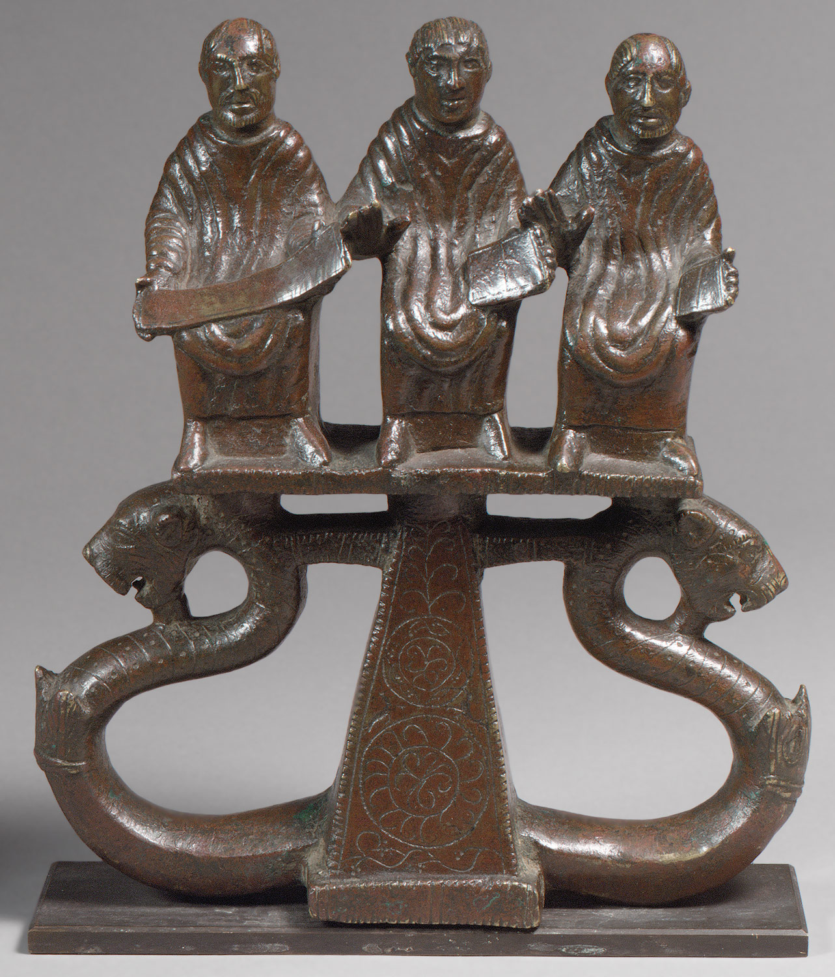
Image taken of found object:
Image taken of found object:

Slide 14
Image taken of found object:
Image taken of found object:

Slide 15
Image taken of found object:
Image taken of found object:

Slide 16
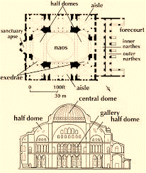

Slide 19
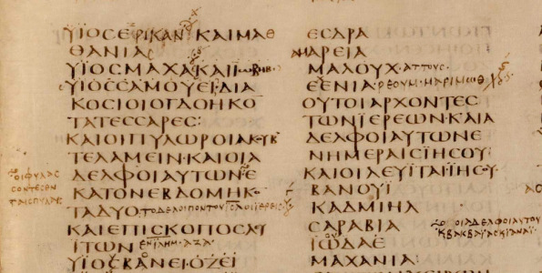

Slide 21
The Byzantine Herald
The Byzantine Herald
Byzantine Sports Beat
Yesterday was another full capacity day at the Hippodrome as 100,000 anxious fans packed the sporting arena to witness the chariot races. As is customary, citizens of all classes received a free token to enjoy the games. The crowd went wild when Emperor Justinian entered the stadium dressed in imperial robes and signaled the start of the races by dropping a white napkin. Once again, the teams consisted of the Blues, Greens, Reds, and Whites who raced numerous exciting matches. The Blues, wearing billowing garments, seemed larger than life. All of the teams carried weapons under their clothes in case violence erupted. Luckily, none did, and it was a relatively riot-free day in the Hippodrome with the Blues winning!
Byzantine Sports Beat
Yesterday was another full capacity day at the Hippodrome as 100,000 anxious fans packed the sporting arena to witness the chariot races. As is customary, citizens of all classes received a free token to enjoy the games. The crowd went wild when Emperor Justinian entered the stadium dressed in imperial robes and signaled the start of the races by dropping a white napkin. Once again, the teams consisted of the Blues, Greens, Reds, and Whites who raced numerous exciting matches. The Blues, wearing billowing garments, seemed larger than life. All of the teams carried weapons under their clothes in case violence erupted. Luckily, none did, and it was a relatively riot-free day in the Hippodrome with the Blues winning!

Slide 22
The Byzantine Herald
The Byzantine Herald
Byzantine Sports Beat
Yesterday was another full capacity day at the Hippodrome as 100,000 anxious fans packed the sporting arena to witness the chariot races. As is customary, citizens of all classes received a free token to enjoy the games. The crowd went wild when Emperor Justinian entered the stadium dressed in imperial robes and signaled the start of the races by dropping a white napkin. Once again, the teams consisted of the Blues, Greens, Reds, and Whites who raced numerous exciting matches. The Blues, wearing billowing garments, seemed larger than life. All of the teams carried weapons under their clothes in case violence erupted. Luckily, none did, and it was a relatively riot-free day in the Hippodrome with the Blues winning!
Byzantine Sports Beat
Yesterday was another full capacity day at the Hippodrome as 100,000 anxious fans packed the sporting arena to witness the chariot races. As is customary, citizens of all classes received a free token to enjoy the games. The crowd went wild when Emperor Justinian entered the stadium dressed in imperial robes and signaled the start of the races by dropping a white napkin. Once again, the teams consisted of the Blues, Greens, Reds, and Whites who raced numerous exciting matches. The Blues, wearing billowing garments, seemed larger than life. All of the teams carried weapons under their clothes in case violence erupted. Luckily, none did, and it was a relatively riot-free day in the Hippodrome with the Blues winning!

Slide 23
The Byzantine Herald
The Byzantine Herald
Byzantine Sports Beat
Yesterday was another full capacity day at the Hippodrome as 100,000 anxious fans packed the sporting arena to witness the chariot races. As is customary, citizens of all classes received a free token to enjoy the games. The crowd went wild when Emperor Justinian entered the stadium dressed in imperial robes and signaled the start of the races by dropping a white napkin. Once again, the teams consisted of the Blues, Greens, Reds, and Whites who raced numerous exciting matches. The Blues, wearing billowing garments, seemed larger than life. All of the teams carried weapons under their clothes in case violence erupted. Luckily, none did, and it was a relatively riot-free day in the Hippodrome with the Blues winning!
Byzantine Sports Beat
Yesterday was another full capacity day at the Hippodrome as 100,000 anxious fans packed the sporting arena to witness the chariot races. As is customary, citizens of all classes received a free token to enjoy the games. The crowd went wild when Emperor Justinian entered the stadium dressed in imperial robes and signaled the start of the races by dropping a white napkin. Once again, the teams consisted of the Blues, Greens, Reds, and Whites who raced numerous exciting matches. The Blues, wearing billowing garments, seemed larger than life. All of the teams carried weapons under their clothes in case violence erupted. Luckily, none did, and it was a relatively riot-free day in the Hippodrome with the Blues winning!

Slide 24
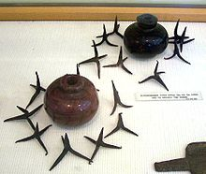
Image of items found:
Image of items found:
Image of items found:
Image of items found:
Image of items found:
Image of items found:

Slide 25
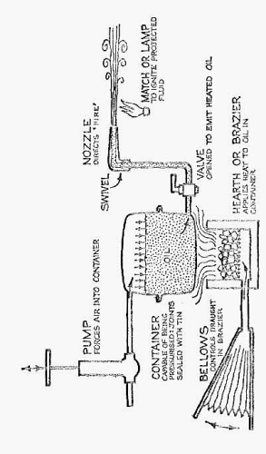
Image of plans found for an artifact:
Image of plans found for an artifact:

Slide 26
Image of plans found for an artifact:
Image of plans found for an artifact:

Slide 27
Image of plans found for an artifact:
Image of plans found for an artifact:

Slide 28
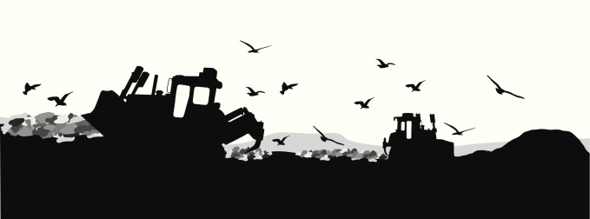
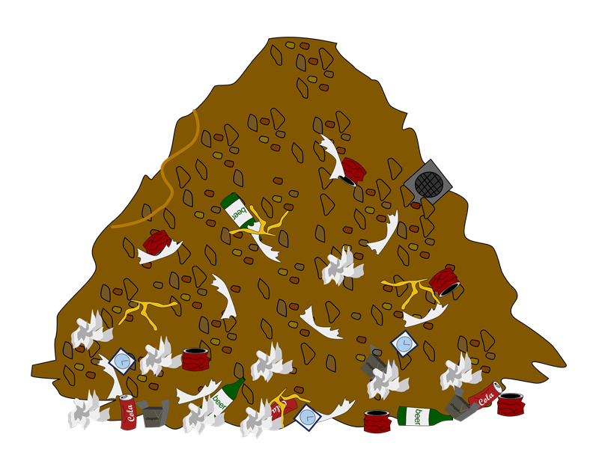
Byzantine Empire Trash Artifact Investigation

Slide 29
Item 1: Copy of Justinian Code
1st page of Book 1
Great accomplishment of Emperor Justinian
Important because it reflects the future of 900 years worth of laws and codes throughout the world

Slide 30
Item #2: Dome-building Instructions
How to build a dome
Important because it shows the Roman-style architecture that was prevalent in the Byzantine Empire

Slide 31
Item #3: Byzantine Coin
Made of gold, which helps show the wealth of the Byzantine Empire
Crosses show importance of Christianity
“Pax” means peace in Latin

Slide 32
Items of #4: Types of Icons
On left: part of a necklace, of Jesus’ mother
Importance shows the rejection of the icon and its vandalism (likely by an iconoclast)
On right: a gold plate with the image of Jesus bestowing peace on someone
Ripped/torn/smashed in 2 shows the rejection of the image of God.

Slide 33
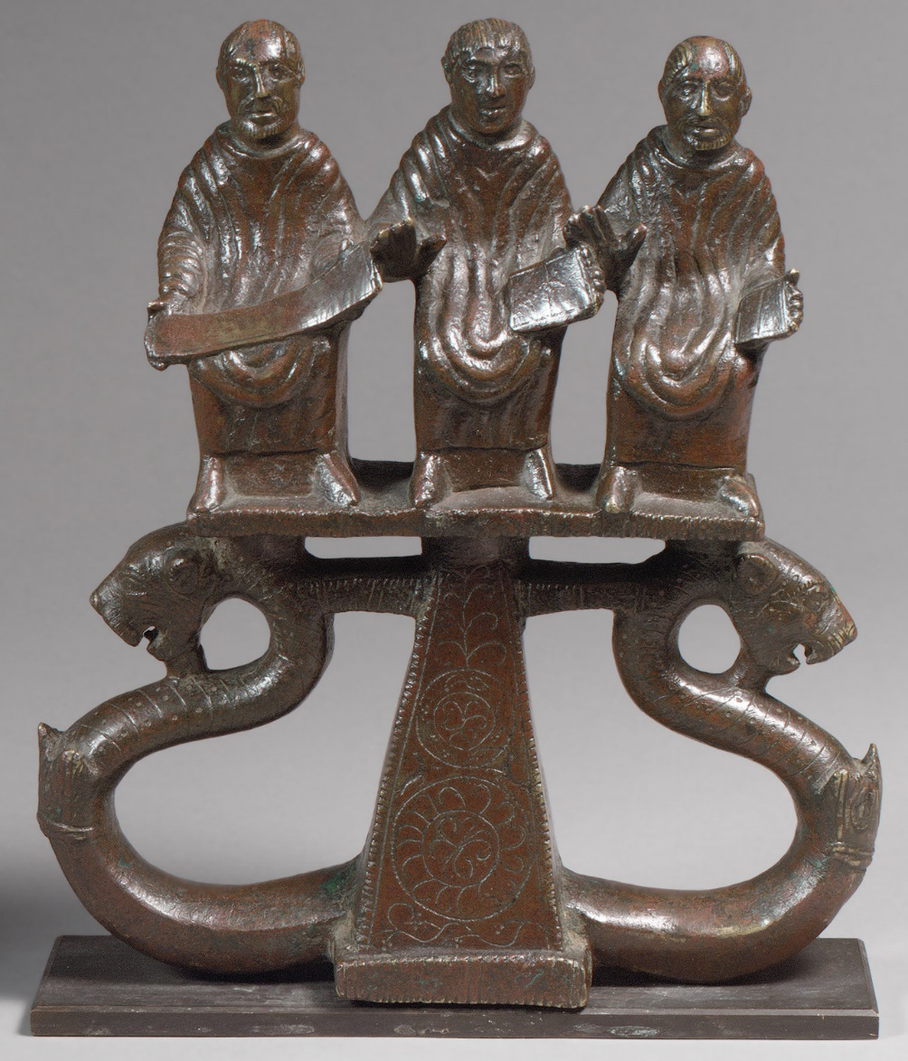
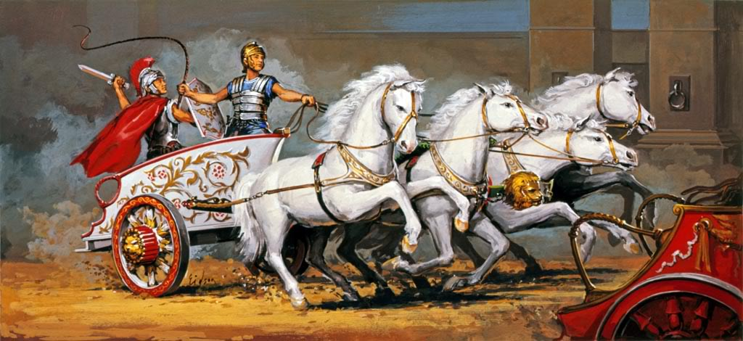
Item #5: Chariot Mount
Used for aid in stepping onto chariot
Shows form of entertainment
The 3 men are orators (speakers, writers) so the owner of the chariot was likely a famous orator.
This shows the important of schooling, learning, and recording information in the empire.

Slide 34
Item #6: layout of the Hagia Sophia
Part of the Hagia Sophia
Shows importance of churches and it shows the Roman-style architecture that was used.

Slide 35
Item # 7: Greek Writing
Paper with Greek writing found
Shows that most of the empire spoke Greek and Latin was not often used
It also shows the importance of recording things, remembering history, and keeping the classical past safe

Slide 36
Item #8: news from the Hippodrome
Newspapers aren’t invented yet, but this represents a conversation or oration (speech) about the events that someone would have said to inform people.
It shows the popular entertainment of chariot racing at the Hippodrome and how it was done.
It shows how often violence occurred and gives us a good idea of the environment where the Nika Revolt started (against Justinian & Theodora).
Byzantine Sports Beat
Yesterday was another full capacity day at the Hippodrome as 100,000 anxious fans packed the sporting arena to witness the chariot races. As is customary, citizens of all classes received a free token to enjoy the games. The crowd went wild when Emperor Justinian entered the stadium dressed in imperial robes and signaled the start of the races by dropping a white napkin. Once again, the teams consisted of the Blues, Greens, Reds, and Whites who raced numerous exciting matches. The Blues, wearing billowing garments, seemed larger than life. All of the teams carried weapons under their clothes in case violence erupted. Luckily, none did, and it was a relatively riot-free day in the Hippodrome with the Blues winning!

Slide 37
Item #9: Greek Fire & Caltrops
Pots= Greek Fire Pots used as grenades during war
Caltrops: spiky metal weapons laid out on the ground and used to slow down horses, elephants, and humans (from stepping on them)
Shows the violence of war and good tactics that helped the empire survive for so long.

